Slide 1
Chapter 17
Common Types of Attacks

Slide 2
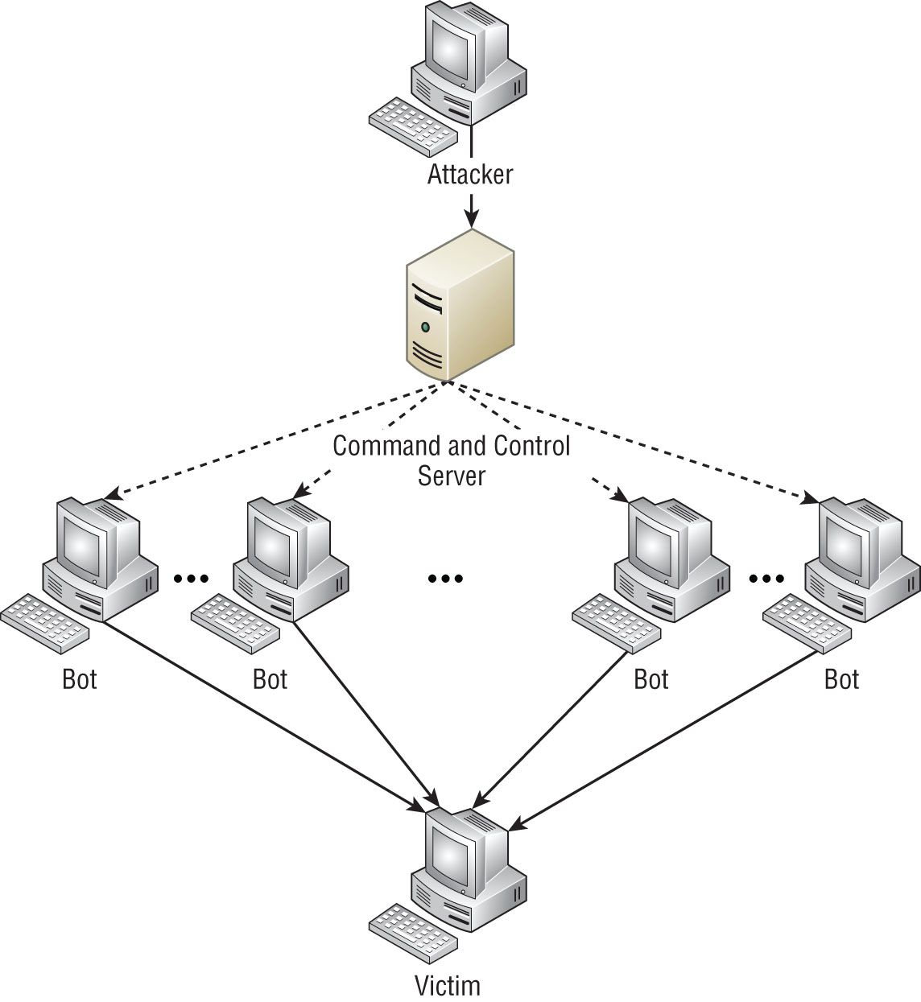
Threats
Denial of Service(DOS)/Ping of Death
Distributed Denial of Service (DDoS)
Botnets
Traffic Spike
Friendly/Unintentional DoS
Physical Attack
Permanent DoS
Notes:
Traffic Spike: major spike in the network as bots are recruited to mount the attack
IDS can be used to prevent them from growing larger or in some cases prevent traffic in the first place
Physical attack: causing damage to hardware
Permanent DoS: the device is damaged and must be replaced

Slide 3
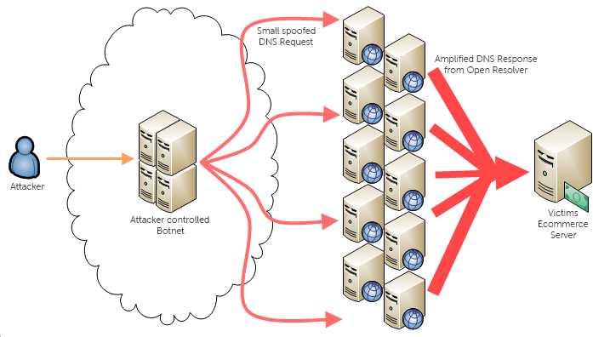
Reflective/Amplified Attack
DNS
Notes:
Sends a request from a spoofed IP address to DNS servers with domains that have 100s of records which will flood an individual’s system with hundreds of replies
DNS amplification attack is a form of reflection attack in that the attacker delivers traffic to the victim by reflecting it off a third party
Relies on the exploitation of publicly accessible open DNS servers to deluge victims with DNS response traffic

Slide 4
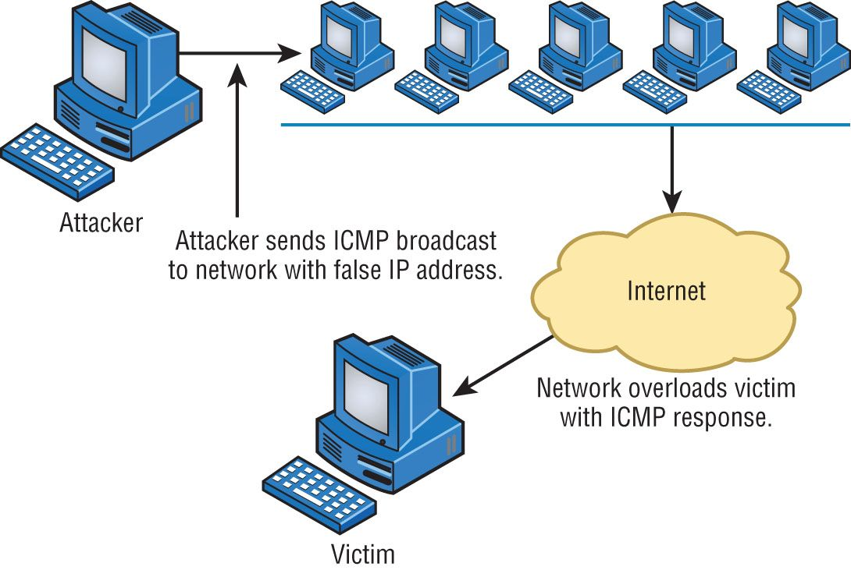
Smurf Attack
A ping is normally unicast
Smurf attack sends the ping out as a broadcast
Smurf attack spoofs the source IP
Directed broadcast through an amplifying network
Notes:
Send 1 echo ICMP request from a spoofed IP address to 15.255.255.255 address which will result in about 16 million replies per request sent

Slide 5
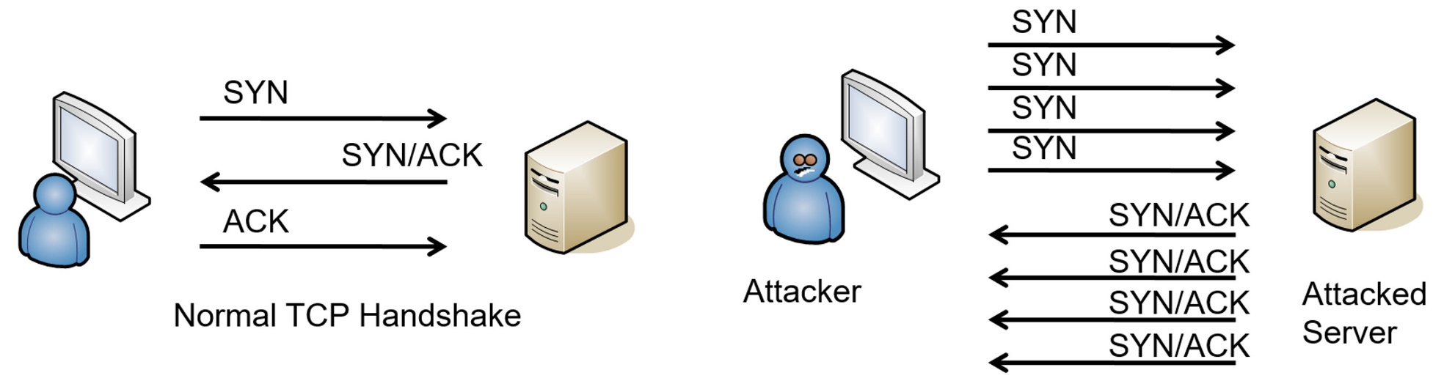
SYN flood attack
Common attack against Internet servers
Disrupts the TCP three-way handshake
Withholds 3rd packet
Notes:
Floods the receiving machine with lots of packets that cause the victim to waste resources by holding connections open

Slide 6
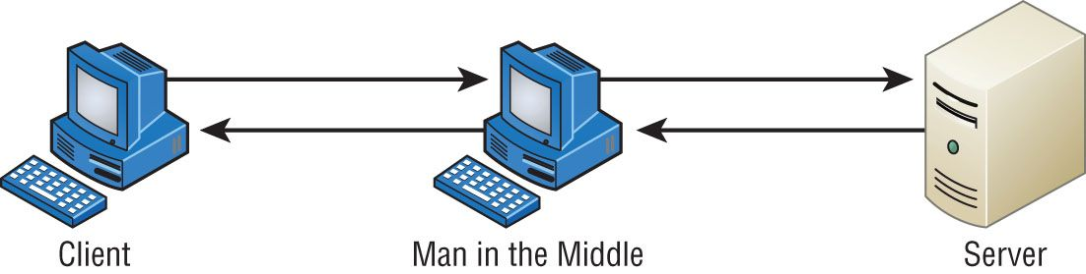
On Path
DNS Poisoning
VLAN Hopping
Double Tagging
ARP Spoofing
Rouge DHCP
Notes:
VLAN hopping attack results in traffic from one VLAN being sent to the wrong VLAN
An attacker can circumvent trunking by double tagging, which applies a fake VLAN tag to a packet along with the real tag
One-way trip
Good for DoS attacks

Slide 7
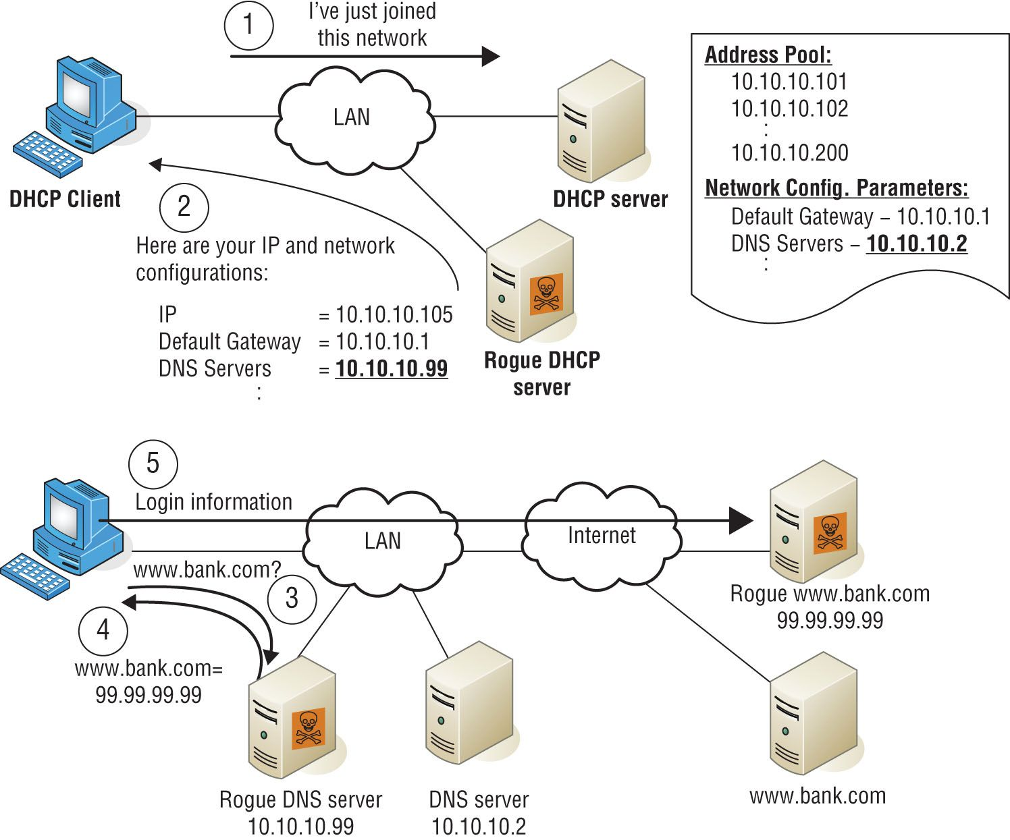
Rogue DHCP
An unsuspecting hosts may accept DHCP Offer packets from the illegitimate DHCP server
Figure 17.7: Rogue DHCP
Notes:
You get an IP address from an unauthorized DHCP server and you have intermittent connectivity or no connectivity at all

Slide 8

More Threats
Memory
Multipartite
Virus
Rouge AP
Evil Twin
Logic Bombs
Ransomware
Boot Sector
Macro Viruses
Multi-partite Virus
Zero Day Attack
Insider Threats
Disk Files
Boot Sector
Notes:
Logic Bomb: time-based or event-based viruses
Macro-virus: a virus that can be ran in a small amount of code
Multi-partite virus: affects both the boot sector and files on your computer, making such a virus particularly dangerous and exasperatingly difficult to remove
Boot-sector: work their way into the master boot record, they overwrite your boot sector, making it appear as if there’s no point to your OS

Slide 9
More Threats
Password Attacks
Brute Force
Dictionary
Rainbow Table
MAC Spoofing
IP Spoofing
Deauthentication
Notes:
Deauthentication: a form of a DoS attack in which the attacker sends a large number of management packets causing stations to be disconnected from the access point

Slide 10
Social Engineering
Phishing
Spear Fishing
Whaling
Tailgating
Piggybacking
Shoulder Surfing
Notes:
Phishing: attempts to learn personal info by posing with a fake website
Piggybacking: is done with authorization of the person with access

